Slide 1
Java Programming: From the Ground Up
Lecture Notes 04
Chapter 10
Objects and Classes II:
Writing Your Own Classes

Slide 2
A Dice Class
An object consists of data and methods, i.e. attributes and behaviors.
An object is instantiated or created according to the specifications of a class.
A Dice class defines the attributes and behaviors of a collection of n six-sided dice.
Each Dice object has a single attribute: an integer indicating the number of dice in the collection.
The behaviors consist of methods that:
“roll the dice” and return the total number of spots displayed on the faces of all the dice,
return the number of dice in the collection, and
change the number of dice in the collection.

Slide 3
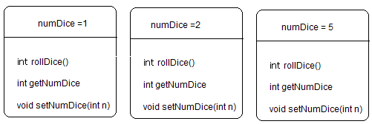
A Dice Class
Three different Dice objects.
A Dice class is an abstraction of a set of n dice objects.

Slide 4
A Dice Class
Use Dice in the same way that you utilize String, Scanner, or Random.
Dice is a class with methods that are available to other classes:
String s = new String (“Hello”);
char ch = s.charAt(3);
Dice d = new Dice();
int value = d.rollDice();

Slide 5
A Dice Class
Problem Statement:
Design a Dice class that models a collection of n six-sided dice.
The class should provide three methods:
int rollDice(), which simulates tossing the dice and returns the total number of spots displayed on the dice,
int getNumDice(), which returns the number of dice in the set; and
void setNumDice(int n), which sets or changes the number of dice.

Slide 6
A Dice Class
Analysis and Design:
Dice contains no main(...) method.
Like the String class, Dice is a class that cannot run independently.
Two constructors
No parameter: Dice() – default 1 die
One parameter for initial number of dice: Dice(int n)
Two data items: int numDice
and: Random random
Three methods:
int rollDice() -- use a Random object and the Random method nextInt(int n), which returns an integer in the range 0 to n – 1.
int getNumberDice() – return numDice
void setNumberDice(int dices) – numDice ← dice

Slide 7
A Dice Class
import java.util.*; // for the Random class
public class Dice
{
private int numDice; // two data items -- fields
private Random random;
public Dice() //default constructor: one die in the set
{
numDice = 1;
random = new Random();
}
public Dice(int n) // one argument constructor -- n dice in the set
{
numDice = n;
random = new Random();
}

Slide 8
A Dice Class
public int rollDice() // Method rollDice
// Returns the number of spots shown when tossing numDice dice
{
int sum = 0;
for (int i = 1; i <= numDice; i++) // for each die in the set
sum += random.nextInt(6) + 1; // sum = an integer // between 1 and 6, inclusive
return sum;
}
public int getNumDice() // Method getNumDice
{
return numDice;
}
public void setNumDice(int n) // Method setNumDice
{
numDice = n;
}
}

Slide 9
A Dice Class
Dice must be saved in a file named Dice.java.
Class declaration: public class Dice
The name of the class is Dice.
Java convention dictates that the name of a class begins with an uppercase letter.
All other letters are lowercase, except those that begin new words.
The word public is an access modifier. If a class is specified as public then the class can be used by any other class. Only one public class can be saved in any file.

Slide 10
A Dice Class
Instance fields:
private int numDice
instance variable or field that specifies the single attribute of the Dice class.
numDice is visible to all methods of the class.
Any method defined in Dice has access to this variable.
Because numDice is specified as private, only the methods of Dice can access or modify numDice.
The private field numDice is not visible outside the Dice class.
Instance variables are usually assigned private access.
Public access specifies that the variable is accessible to all code outside the class and a variable with no access modifier is accessible to classes within its package.
private Random random
To generate a random number
Can be constant, never changed

Slide 11
A Dice Class
Default Constructor:
public Dice() // the default constructor -- one die
{
numDice = 1;
}
the class’s default constructor. The default constructor is like a method but there is no return value, not even void.
The name of the default constructor is the same as the class name.
The default constructor creates or instantiates a new object of the Dice class, that is, the default constructor transparently allocates memory for each object of a class.
The access modifier for the default constructor is usually public.

Slide 12
A Dice Class
The default constructor executes the statements enclosed by the curly braces. Here, the default constructor assigns the value 1 to the instance variable numDice. The default constructor is called automatically when a dice object is instantiated with a statement such as:
Dice dice = new Dice();
or
Dice dice;
dice = new Dice();
In other words, the default constructor
instantiates a Dice object, and
initializes a Dice object.
Another name for the default constructor is the no-argument constructor.
A program cannot call the default constructor directly; it is invoked via the new operator.

Slide 13
A Dice Class
One-argument constructor:
public Dice(int n) // the
{
numDice = n;
}
Like the default constructor, the one argument constructor creates a Dice object and initializes the instance variable numDice.
When create an object:
Dice d = new Dice(2);
There is no limit to the number of constructors that you can include in a class definition.
A two-argument constructor might have the form:
public Dice( int numBlueDice, int numRedDice)
{
numDice = numBlueDice + numRedDice;
}

Slide 14
A Dice Class
Method – int rollDice():
The method rollDice() simulates rolling the set of dice according to the following algorithm:
Declare a local variable sum.
Instantiate a Random object, random.
For each die in the set, i.e. for i = 1 to numDice, a. generate a random number between 1 and 6, inclusive, and b. add the random number to sum.
return sum.
The method rollDice() has an access modifier.
The public access modifier specifies that the method is visible and accessible outside the Dice class.

Slide 15
A Dice Class
Method -- int getNumDice():
The public method getNumDice() returns the value of numDice.
The method getNumDice() provides access to numDice.
A method such as getNumDice() that returns the value of some private variable is called a getter method.
Method -- void setNumDice(int n):
Like getNumDice(), the public method setNumDice(int n) provides access to the instance variable numDice via a method.
This method sets numDice to the value of parameter n.
A method that assigns or alters the value of an instance variable is called a setter method.

Slide 16
A Test Class for Dice
public class TestDice
{
public static void main(String[] args) // for testing the Dice class
{
Dice d1 = new Dice();
Dice d2 = new Dice(2);
System.out.println( “d1: numDice = “ + d1.getNumDice());
System.out.println( “d2: numDice = “ + d2.getNumDice())
for (int i = 1; i <= 10; i++)
System.out.println(d1.rollDice() + “ “+ d2.rollDice());
d1.setNumDice(5);
System.out.println( “d1: numDice = “ + d1.getNumDice());
for (int i = 1; i <= 10; i++)
System.out.println(d1.rollDice() );
}
}

Slide 17
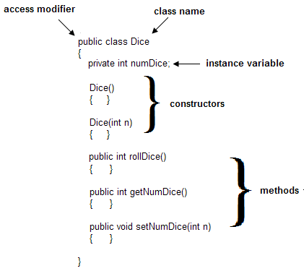
A More General Look At Classes
Each class that we write has the following structure:
[access modifier] class name
{
instance variables or fields
constructors
methods
}

Slide 18
A More General Look At Classes
A class’s access modifier is optional. For now, we designate each of our classes as public.
Java specifies that only one public class can be saved in any file, so each class must be saved in a separate file.
The name of the file must be classname.java.
For example, the Dice class is a public class and must be saved as Dice.java.
The name of a class must be a valid Java identifier.
Java convention dictates that each class name begins with an uppercase letter.
All other letters of a class name are lowercase except those that begin new “words.”
Some other permissible and reasonable names for the Dice class are: MyDice, MyLoadedDice, or SkyMastersonsDice.

Slide 19
A More General Look At Classes
A class can have any number of instance variables or fields.
The instance variables comprise the attributes of a class.
These variables are accessible to all methods of the class.
Each field has an optional access modifier:
public – The field is visible outside the class.
private – The field is visible only to the methods of the class
Normally, we specify instance variables as private.
Private instance variables are accessible only to the methods of the class.
Usually, a class’s methods regulate all access to the instance variables.
The Dice class has just two instance variables, numDice and random, which both are private.

Slide 20
A More General Look At Classes
Each class has at least one constructor.
A constructor is automatically executed each time an object of the class is instantiated.
A constructor initializes instance variables but it can also perform other computations.
The name of a constructor is the same as the class name.
A constructor does not have a return value.
The default constructor (no-argument constructor) is a constructor with no parameters.
The Dice class has two constructors:
the default constructor: public Dice()
one-argument constructor: public Dice(int n)

Slide 21
A More General Look At Classes
If a class does not implement a constructor, Java provides a default, no-argument constructor.
An application can create an object with Java's default constructor using a statement such as:
MyClass myClass = new MyClass();
// default constructor provided by Java
If a class provides any constructors, Java does not provide a default constructor.
The methods of the class specify the behaviors of the class.
Each method may be qualified with an optional access modifier public or private.
A private method intended for use only within its class.

Slide 22
Using the Dice Class
Once a class is implemented and debugged, using the class is no different than using one of Java’s own classes such as String, Random, File, or Scanner.
Example
The ancient Japanese game Cho-Han is played with a pair of standard dice that are shaken and tossed.
Players place a wager on whether the sum of the dice is odd (“cho”) or even (“han”).
A player wins or loses an amount equal to his/her bet.

Slide 23
Using the Dice Class
Problem Statement:
Write a class that simulates the game of Cho-Han.
The class should:
ask a player for a bet, an integer,
play a round of Cho-Han,
report the result along with the cumulative winnings or losses (a positive or negative integer), and
inquire whether or not the player wishes to play again and, if so, repeat the game.
When a player decides that he/she would like to quit, the program should report the total winnings or losses for the session.

Slide 24
Using the Dice Class
Program Analysis and Design:
A ChoHan class consists of one instance variable or field, winnings, a default constructor that initializes winnings to 0, and three methods:
A void method play() that:
asks for the wager and whether he/she chooses odd or even,
rolls the dice,
adjusts the winnings based on the outcome of the bet,
inquires whether or not the player wishes to continue playing.
The play() method uses the Dice class.
A boolean method won() that determines whether or not a player has won the game.
This method is specified as private because it is intended for use only within the class. No other class has access to this method.
A void method reportWinnings() that displays the amount of money won or lost at the conclusion of all play.
Like won(), this method is used only in the class.

Slide 25
Using the Dice Class
import java.util.*; // for the Scanner and Random classes
public class ChoHan
{
private int winnings; // total won or lost (negative)
public ChoHan() // default constructor
{
winnings = 0;
}
// an auxiliary method, used only in the class
private boolean win (String choice, int sum) // win or lose
{
if ( sum%2 == 0 && (choice.equals("e") || choice.equals("E"))) //even
return true;
if ( sum%2 != 0 && (!(choice.equals("e") || choice.equals("E")))) //odd
return true;
return false;
}

Slide 26
Using the Dice Class
public void play()
{
Scanner input = new Scanner(System.in);
Dice dice = new Dice(2); // Dice object instantiated; constructor called
String choice; // even or odd
String answer; / play again or not
int wager; // how much
do
{
System.out.print("Enter wager: ");
wager =input.nextInt();
System.out.print("Enter 'e' for even anything else for odd: ");
choice = input.next();
int sum = dice.rollDice(); // invoke method of Dice class
System.out.println("You rolled a "+ sum);
if ( win(choice, sum ))
{
winnings += wager;
System.out.println("You won! Winnings so far: "+ winnings);
}

Slide 27
Using the Dice Class
else
{
winnings -= wager;
System.out.println("You lost! Winnings so far: " + winnings);
}
System.out.print("Play again? 'y' or 'Y' for 'Yes': "); //anything else for "no"
answer = input.next();
System.out.println();
}while(answer.equals("Y") || answer.equals("y"));
reportWinnings();
}
private void reportWinnings()
{
if (winnings > 0)
System.out.println("You won $"+ winnings);
else if (winnings < 0)
System.out.println("You lost $"+ Math.abs(winnings));
else
System.out.println("You broke even ");
System.out.println("Thanks for playing");
}

Slide 28
Using the Dice Class
The following small class instantiates one ChoHan object and invokes the play() method of that object.
The class is saved in a file named PlayChoHan.java
public class PlayChoHan
{
public static void main(String[] args)
{
ChoHan game = new ChoHan(); // create a game
game.play(); // start the game
}
}

Slide 29
Using the Dice Class
Together the classes Dice, ChoHan and PlayChoHan make up an application.
PlayChoHan contains a main(...) method; so PlayChoHan is the class that executes.
When PlayChoHan starts execution, the statement:
ChoHan game = new ChoHan();
invokes the default constructor of the ChoHan class. The constructor instantiates a ChoHan object, game, and initializes the instance variable, winnings, to 0.
Once a ChoHan object is created, the object’s play() method is invoked.
The play() method begins with the instantiation of two objects: a Scanner object, input, and a Dice object, dice.
Accordingly, play() invokes two constructors on lines 20 and 21:
20. Scanner input = new Scanner(System.in);
21. Dice dice = new Dice(2); // creates a Dice object with 2 dice.
ChoHan contains two private methods: win() and reportWinnings(), on lines 10 and 49, respectively. These methods are not accessible outside the class

Slide 30
Static Data or Class Variables
In addition to instance variables, a Java class may also define class variables or static variables.
We use the keyword static to denote a class variable.
A static variable belongs to the class and not to any particular object; a class or static variable is shared by all objects of the class.
Once defined in a class, a static variable exists whether or not any objects have been created; and no matter how many objects exist, only one copy of any static variable can exist.
A static variable serves all objects of a class.
Static data is not stored in an individual object but in a separate location, and all objects of a class have access to this one location.

Slide 31
Static Data or Class Variables
An Employee class models an individual employee and that each employee has a unique weekly income.
A static variable totalPayroll might hold the grand total of all salaries for the week.
Only one copy of totalPayroll is necessary.
All objects share totalPayroll.

Slide 32
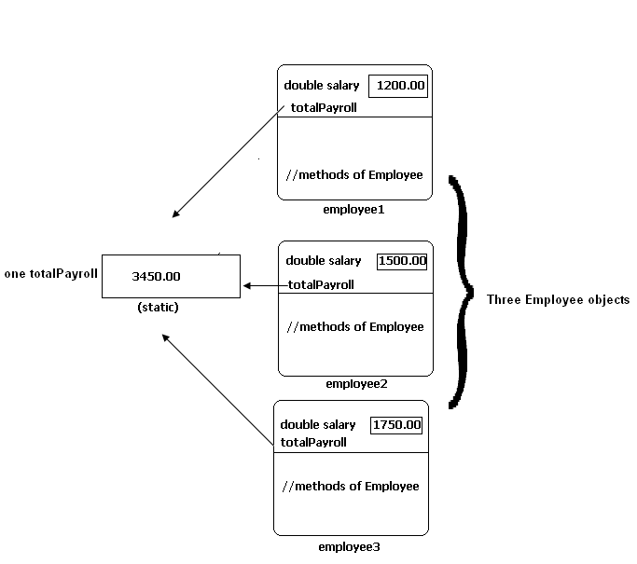
Static Data or Class Variables
All Employee objects share the same static variable, totalPayroll

Slide 33
Static Data or Class Variables
A static variable is handy if you need to know how many objects of a class exist.
The following class is a version of the Dice class with an added static variable, numDiceObjects that keeps track of the number of Dice objects that are instantiated.
import java.util.*;
public class Dice
{
private int numDice;
private Random random;
static private int numDiceObjects = 0;
// the keyword static denotes a class variable.
public Dice() // default constructor -- one die
{
numDice = 1;
random = new Random();
numDiceObjects++;
}
public Dice(int n) // constructor --n dice
{
numDice = n;
random = new Random();
numDiceObjects++;
}
public int rollDice()
// Returns the number sum when tossing all dice
{
int sum = 0;
for (int i = 1; i <= numDice; i++) // for each die
sum += random.nextInt(6) + 1;
// sum = an integer between 1 and 6, inclusive
return sum;
}
public int getNumDice()
{
return numDice;
}
public void setNumDice(int n)
{
numDice = n;
}
public int getNumDiceObjects()
{
return numDiceObjects;
}
}

Slide 34
Static Data or Class Variables
Line 6 includes the static modifier as well as an initialization.
The constructors do not initialize numDiceObjects but instead increment this static variable thus keeping track of the number of Dice objects that have been created.
Every time a new Dice object is created, the constructor increases numDiceObjects by one.
If the initialization of numDiceObjects had been placed in the constructor, numDiceObjects would be reset to 0 each time a new object was created.
The initialization on line 4 is performed just once, and not every time a new object is created.

Slide 35
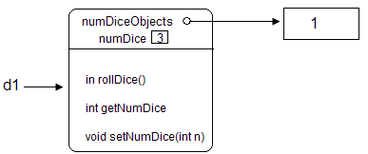
Static Data or Class Variables
Lines 1-3 instantiate 3 Dice objects and the static variable numDiceObjects has the value 3.
Dice d1 = new Dice(3);
Dice d2 = new Dice(7);
Dice d3 = new Dice(5);
Each time a Dice constructor is invoked, numDiceObjects increases.
Dice d1 = new Dice(3);
Static variable numDiceObjects has the value 1

Slide 36
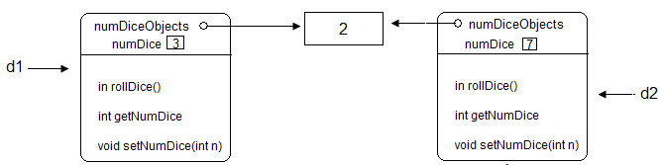
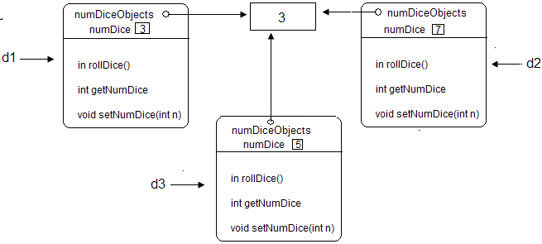
Static Data or Class Variables
Dice d2 = new Dice(7);
Static variable numDiceObjects has the value 2.
Dice d3 = new Dice(5);
Static variable numDiceObjects has the value 3

Slide 37
Static Data or Class Variables
Because the value of a constant is final and cannot be changed, it makes sense to store a constant just once instead of in each object of the class.
public class Circle
{
static private double totalArea = 0.0; //class variable
public final static double PI = 3.14159; //class variable
private double radius;
public Circle() //default constructor
{
radius = 1;
totalArea = totalArea + PI*radius*radius; // adds to the class variable
}
public Circle(double r) //one argument constructor
{
radius= r;
totalArea = totalArea + PI*radius*radius; // adds to the class variable
}
// The Circle class presumably has other methods besides constructors,
// perhaps area() and circumference().
}

Slide 38
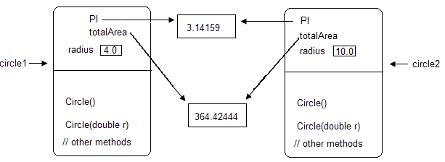
Static Data or Class Variables
PI and totalArea are static variables
All object share these variables

Slide 39
Static Data or Class Variables
Since PI exists whether or not any Circle object exists, access to PI (or any other accessible static variable) can be achieved by using the class name instead of an object identifier:
Circle.PI
PI can also be accessed via any Circle object:
Circle c = new Circle(3.5); Circle c = new Circle(3.5);
double x = c.PI* 15; double x = Circle.PI* 1

Slide 40
Static Data or Class Variables
In general, if a class contains a static variable,
all objects/instances of the class share that variable;
there is only one variable or storage location allocated to the whole class;
the variable belongs to the class and not to any particular object;
the variable exists regardless of whether or not any objects have been created; and
the variable may be accessed using either the class name or an object name, if an object has been created.

Slide 41
Static Methods
A static method is a class method and exists whether or not any objects exist.
A static method, indicated by the keyword static placed before the method’s return type, belongs to the defining class.
Unlike a non-static or instance method that must be invoked via an object, a static method may be called whether or not an object of the class exists.
A static method exists apart for objects.
The methods Math.random(), Math.sqrt(), and Math.abs() are all static methods.
Every method of Java’s Math class is static.
A static method may be invoked by sending a message to an object, if one exists, or by using the class name.
A static method may be called whether or not an object of the class exists, but a static method cannot invoke an instance method except via an object.

Slide 42
The keyword this
The one argument constructor of the Dice class:
public Dice(int n)
{
numDice = n;
random = new Random();
}
The statenment:
numDice = n;
assigns n to the instance variable numDice.

Slide 43
The keyword this
The parameter name can also be numDice, the same name as the instance variable.
Doing this, however, requires some way of distinguishing the instance variable numDice from the parameter numDice.
If the parameter is also named numDice, the constructor has the form:
public Dice(int numDice)
{
numDice = numDice; //which numDice????
random = new Random();
}

Slide 44
The keyword this
The compiler always assumes that numDice in the statement
numDice = numDice;
refers to the local variable, i.e., the parameter.
Thus, the statement reassigns the parameter numDice its own value, and the instance variable numDice is not assigned any value.
To distinguish between the instance variable and the parameter, Java provides the reference this.
The reference this refers to the current instance of a class, the object currently being used.

Slide 45
The keyword this
By using this, an object can refer to itself
public Dice( int numDice)
{
this.numDice = numDice;
// this.numDice is the instance variable numDice
random = new Random();
}
In the assignment statement, the variable this.numDice refers to the instance variable numDice, that is, the numDice that belongs to “this class,” the object currently being created, and not the parameter numDice.

Slide 46
Using this With a Method Call
The Rectangle class uses this in both the two-argument constructor and the method biggerRectangle().
public class Rectangle
{
private int length, width;
public Rectangle ()
{
int length = width = 0;
}
public Rectangle (int length, int width)
{
this.length = length; // this.length – is the instance variable length
this.width = width; // this.width – is the instance variable width
}
public int area()
{
return length * width;
}
public Rectangle biggerRectangle (Rectangle r) // returns the rectangle with larger area
{
if ( this.area() > r.area()) // this.area() returns the area of the current (calling) object
// r.area() returns the area of the parameter object
return this; // return a reference to "this object" -- the calling object
else
return r;
}
public static void main(String[] args)
{
Rectangle r1 = new Rectangle( 3,5);
Rectangle r2 = new Rectangle (1,4);
Rectangle r3= r1.biggerRectangle(r2); // r1 is the caller; r1 is "this Rectangle"
System.out.println("The larger area is " +r3.area());
}
}

Slide 47
Garbage Collection
The following segment incrementally builds the string “Happy”:
String s = new String(“H”); // s → “H”
s += “a”; // s → ”Ha”
s += “p”; // s → “Hap”
s += “p”; // s → “Happ”
s += “y’; // s → “Happy”
String objects are immutable and each concatenation operation causes the instantiation of a new String object.
Thus, the above segment creates five different String objects.
Each time a new object is created, its address is assigned to the reference variable s.
After line 5 executes, there are four unreferenced String objects in existence.

Slide 48
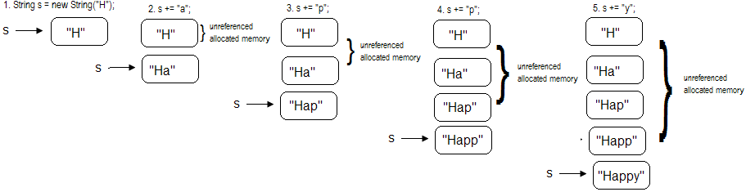
Garbage Collection
With the creation of each new String object, previously created objects are no longer accessible

Slide 49
Garbage Collection
The Java Virtual Machine automatically reclaims all memory allocated to unreferenced objects for future use.
If an object is no longer referenced and accessible, the memory allocated to that object is freed and made available for the creation of other objects.
This clean-up process is called garbage collection.
Java’s garbage collection is more like recycling.
Java’s garbage collector periodically determines which objects are unreferenced and reclaims the space allocated to those objects.
As a program runs, garbage collection occurs transparently in the background.

Slide 50
Garbage Collection
If an object remains referenced but is no longer used in a program, the garbage collector does not recycle the memory:
Square mySquare = new Square (5.0); // a 5.0 x 5.0 square
double areaSquare = mySquare.area();
Triangle myTriangle = new Triangle(6.0, 8.0); // right triangle base = 6.0, height = 8.0
double areaTriangle = myTriangle.area();
Circle myCircle = new Circle(4.0); // a circle of radius 4.0
double areaCircle = myCirclearea();
…
// code that uses these objects
…
// more code that does not use the objects created above ...

Slide 51
Garbage Collection
When Square, Triangle and Circle objects are no longer used by the program, if the objects remain referenced, that is, if references mySquare, myTriangle, and myCircle continue to hold the addresses of these obsolete objects, the garbage collector will not reclaim the memory for these three objects.
Such a scenario causes a memory leak.
A memory leak occurs when an application fails to release or recycle memory that is no longer needed.
The memory leak caused by the Square-Triangle-Circle fragment can be easily rectified by adding a few lines of code.

Slide 52
Garbage Collection
Square mySquare = new Square (5.0); // a 5.0 x 5.0 square
double areaSquare = mySquare.area();
Triangle myTriangle = new Triangle(6.0, 8.0); // right triangle base = 6.0, height = 8.0
double areaTriangle = myTriangle.area();
Circle myCircle = new Circle(4.0); // a circle of radius 4.0
double areaCircle = myCircle.area()
// code that uses these objects
…
mySquare = null;
myTriangle = null;
myCircle = null;
// more code that does not use the objects created above ...
The Java constant null can be assigned to a reference.
A reference with value null refers to no object and holds no address; it is called a void reference.

Slide 53
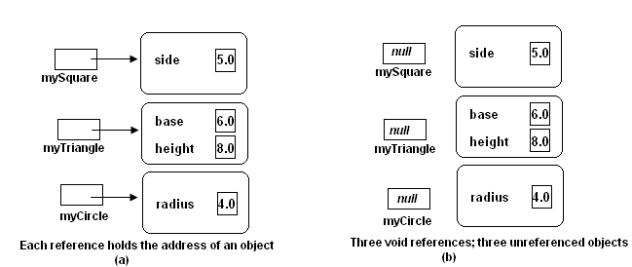
Garbage Collection
Referenced and unreferenced objects

